Slide 1


Data Analysis of
Retail Sales

Slide 2

Contents
Data Analysis

Slide 3

01
Data Analysis

Slide 4


Goal
To understand the patterns of each product category via month and its total amount revenue, that help to clarify what the most preferred category in this store, and the customer behavior

Slide 5
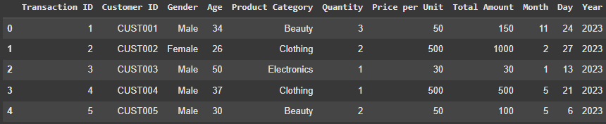
Dataset Overview
Transaction ID
Customer ID
Gender
Age
Product Category
Price per Unit
Total Amount
Month
Day
Year
Shape (1000, 10)

Slide 6
Data Dictionary
Transaction ID: number of transactions
Customer ID: number of customers, unique values
Gender: gender of customer (Male, Female)
Age
Product Category: type of product (Clothing, Electronics, Beauty)
Price per Unit: price of each category product by unit
Quantity: number of products sold
Total Amount: the amount of quantity by price per unit (revenue from the product)
Month
Day
Year

Slide 7

Visual
Analysis

Slide 8
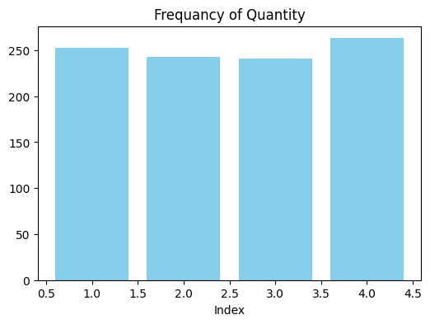
Frequency Distribution of Quantity Purchased
Key Observations:
All four quantity levels (Index 1 to 4) appear with similar frequency, ranging from approximately 250 to 260 occurrences.
The distribution is balanced, with no dominant or rare quantity level.
Insight:
Customers tend to purchase in consistent quantities, suggesting stable buying behavior across the dataset.
Recommendation:
Maintain current quantity options, as they align well with customer habits.
Consider testing bundled offers or promotions to explore potential shifts in quantity preferences.

Slide 9
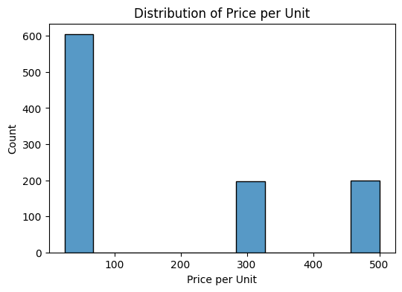
Distribution of Price per Unit
Key Observations:
Majority of units are priced around 100, with approximately 600 instances.
Higher price points (300 and 500) each appear about 200 times.
Insight:
Strong customer preference for lower-priced items, indicating price sensitivity.
Recommendation:
Maintain competitive pricing at the 100-unit level with targeted promotions.
Explore strategies to boost appeal of higher-priced products—e.g., bundling, premium positioning, or added value features.

Slide 10
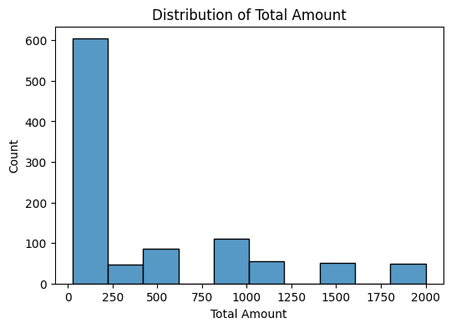
Total Amount Analysis
Key Observations:
The bulk of purchase amounts are 250 or less, with nearly 600 instances.
Fewer transactions are observed as the total amount increases.
Insight:
Purchasing patterns indicate customers prefer lower total spend.
Recommendation:
Develop marketing strategies focused on smaller, frequent purchases.
Implement loyalty programs that encourage higher spending.

Slide 11
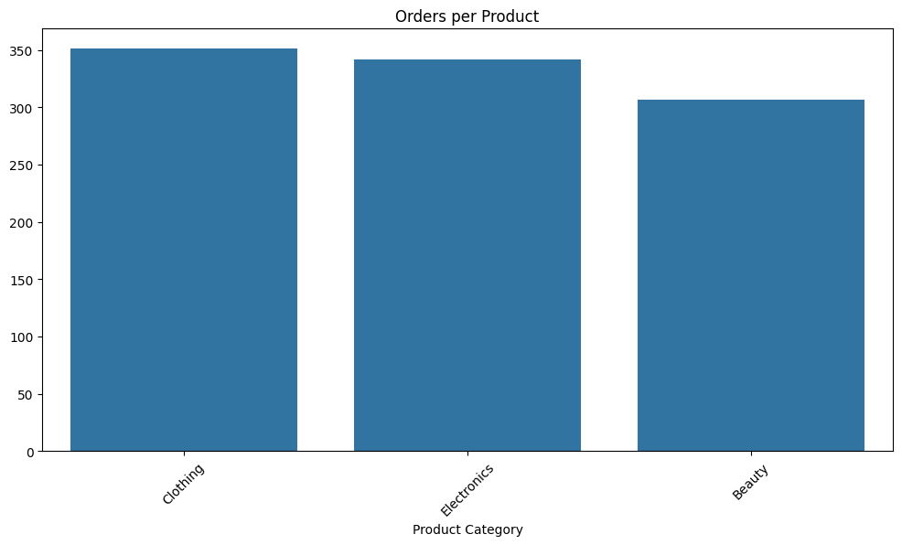
Orders per Product Analysis
Key Observations:
Clothing leads in the number of orders, followed by Electronics and Beauty.
All categories receive a significant number of orders, with Clothing slightly ahead.
Insight:
Customer interest spans across all product categories, with a slight preference for Clothing.
Recommendation:
Boost inventory and marketing efforts for the Clothing category to leverage its popularity.
Introduce promotional campaigns for Electronics and Beauty to enhance competitive standing.

Slide 12
Relation& Corrolation Analysis

Slide 13
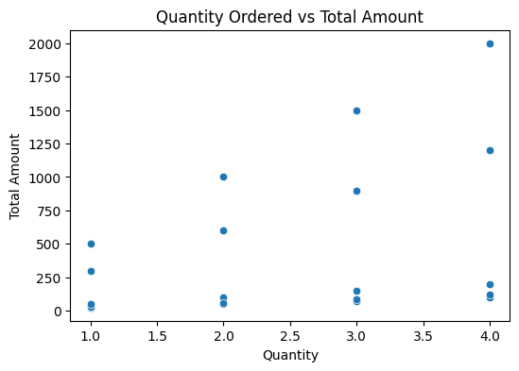
Quantity Ordered vs Total Amount
Key Observations:
Most orders are of lower quantities (1 and 2), with varied total amounts.
Higher quantities (3 and 4) correlate with both lower and higher total amounts.
Insight:
There is no clear trend between quantity ordered and total amount.
Recommendation:
Analyze price elasticity to better understand the relationship between quantity and total spend.
Consider incentives or discounts for higher quantity purchases without eroding profitability.

Slide 14
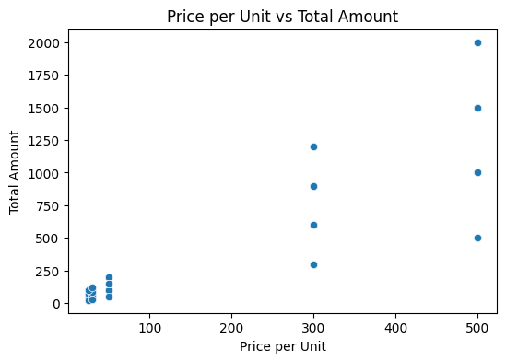
Price per Unit vs Total Amount
Key Observations:
Lower price points (~100) are aligned with smaller total amounts due to higher purchase frequency.
Higher price points (300 and 500) have a broader distribution of total amounts.
Insight:
Customers are more frequently purchasing lower-priced items, but higher-priced items contribute more significantly per sale.
Recommendation:
Implement cross-selling and upselling techniques for lower-priced products to increase total sale amounts.
Highlight the value proposition of higher-priced products through detailed descriptions and customer testimonials.

Slide 15
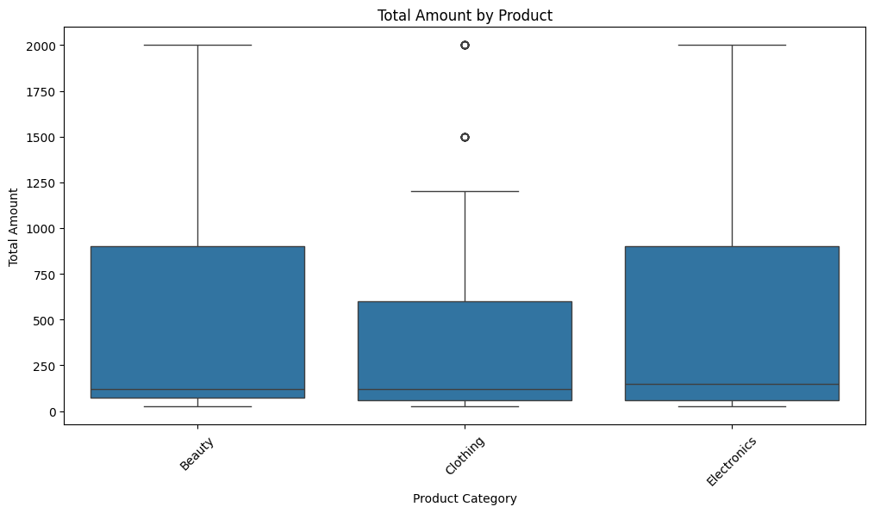
Total Amount by Product
Key Observations:
Beauty shows the highest median total amount, while Clothing has the lowest.
All categories exhibit outliers, with Beauty and Electronics having higher ranges.
Insight:
Beauty and Electronics yield greater sales amounts, while Clothing represents lower-value purchases.
Recommendation:
Target high-value promotions for Beauty and Electronics to maximize revenue.
Evaluate product assortment in Clothing to boost high-value sales.

Slide 16
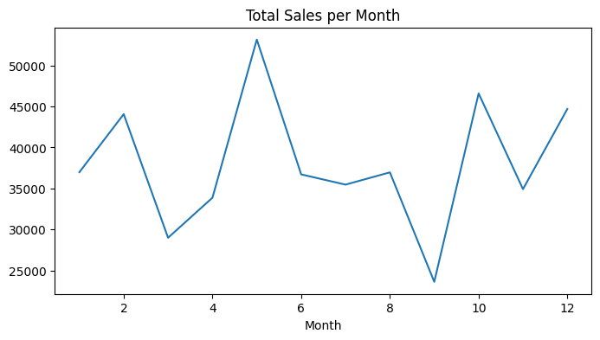
Total Sales per Month
Key Observations:
Monthly sales are inconsistent, with peaks in months 5 and 10.
Noticeable dips occur in months 3 and 9.
Insight:
Significant variability in monthly performance suggests a lack of consistent drivers of sales.
Recommendation:
Analyze factors contributing to peak months to replicate success.
Develop targeted strategies to mitigate downturns and enhance performance stability.

Slide 17
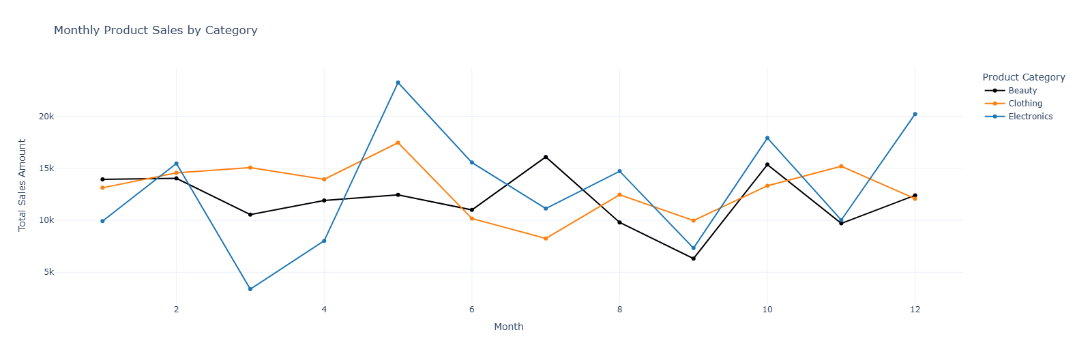
Monthly Product Sales by Category

Slide 18
Monthly Product Sales by Category
Key Observations:
Clothing sells steadily each month, with minimal fluctuations.
Beauty and Electronics fluctuate significantly month over month.
Electronics peaks sharply around the middle and end of the year.
Insight:
Beauty and Electronics are more susceptible to seasonal trends than Clothing.
Recommendations:
Plan inventory and marketing campaigns for Beauty and Electronics around peak periods.
Monitor stock levels in Beauty and Electronics to avoid understocking.

Slide 19
Final Analysis &
Insights, Recommendation

Slide 20
Key Insights
Customers show a strong preference for lower-priced and lower-quantity purchases, indicating price sensitivity and cautious spending behavior.
Clothing is the most frequently ordered category, but Beauty and Electronics generate higher total sales per transaction.
Monthly sales trends reveal seasonal peaks, especially for Electronics, suggesting time-sensitive buying patterns.
Quantity and price per unit do not always correlate directly with total spend, highlighting the need for deeper behavioral segmentation.

Slide 21
Strategic Recommendations
Pricing Strategy: Maintain competitive pricing for popular low-cost items while enhancing the perceived value of premium products.
Inventory Planning: Prioritize stock for high-performing categories and peak sales months to avoid missed opportunities.
Marketing Focus: Launch targeted campaigns around seasonal peaks, especially for Electronics and Beauty.
Customer Engagement: Introduce loyalty programs and bundle offers to encourage higher quantity purchases and repeat business.
Product Optimization: Reassess the Clothing category’s product mix to boost transaction value and align with top-performing segments.

Slide 22

Presented by Rama Al Saket
Thank you very much!

